Slide 1
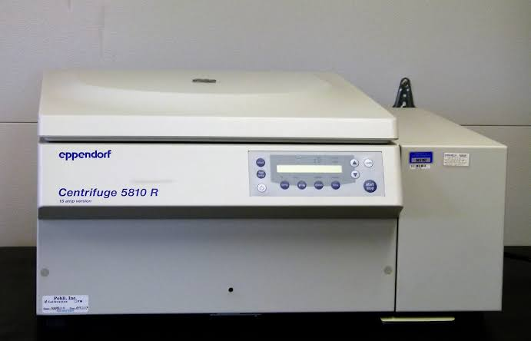
CENTRIFUGE INSTRUCTIONS

Slide 2
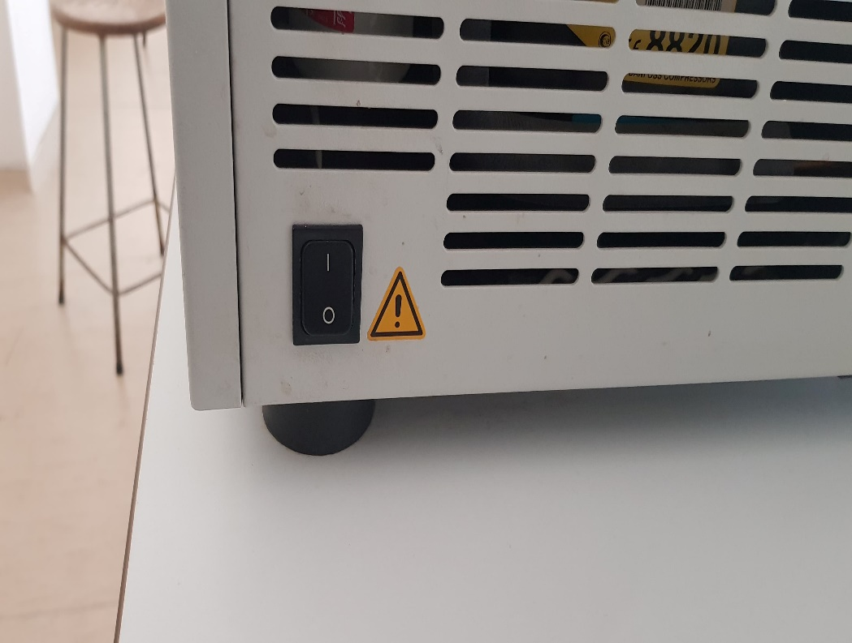
Plug the mains plug of the device into a suitable socket and operate the controller using the POWER on the side.

Slide 3
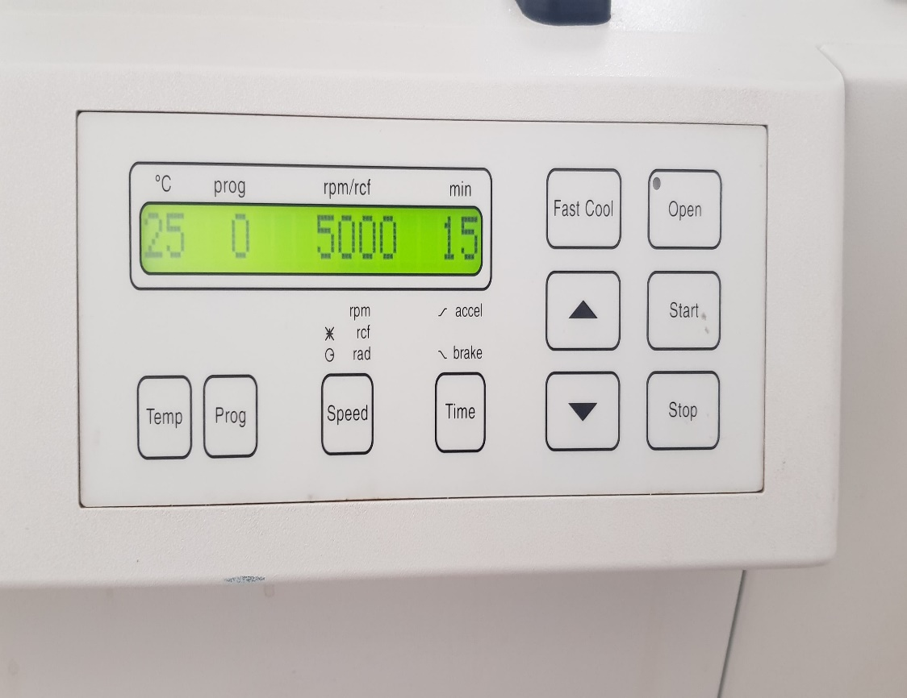
Open the lid of the device by pressing the lid.

Slide 4
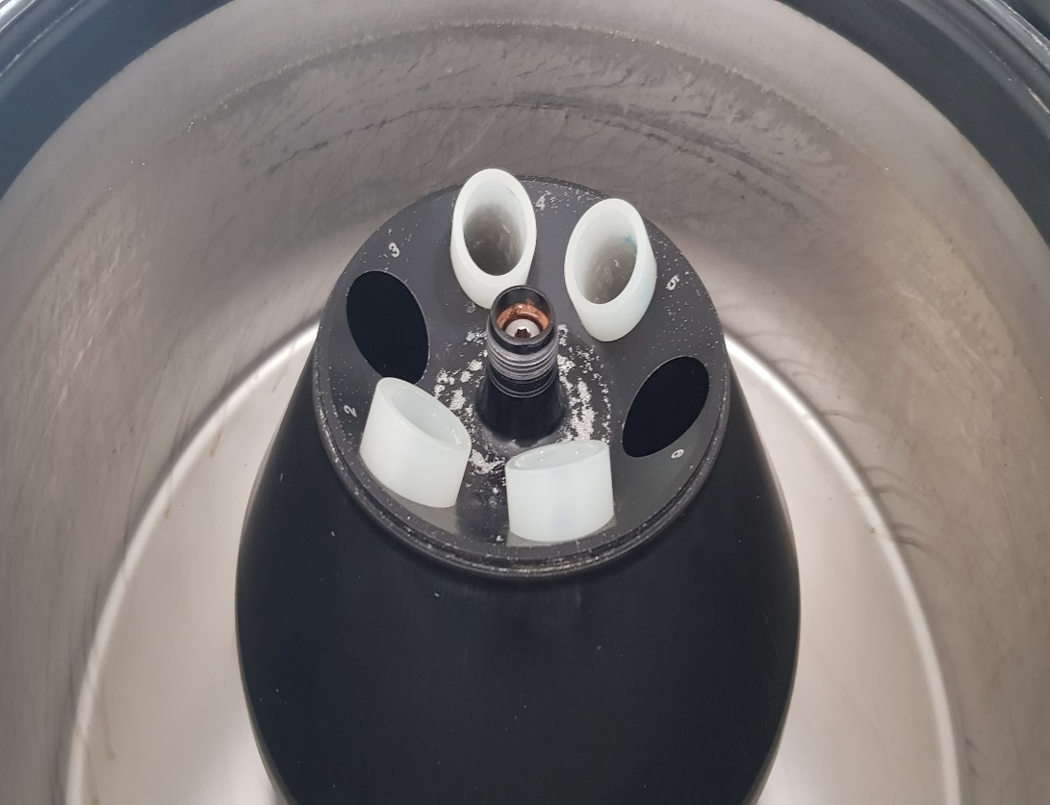
Weigh your samples in a tube suitable for the rotor (together with the fixing holes), close the rotor and centrifuge caps (Caution: Weights of the samples at the same time for rotor balance).

Slide 5
Start the centrifugation function using the "Start" button.

Slide 6
When the centrifugation process is complete (beep sound), wait until speed of rotor becomes “0” , then open the lid.

Slide 7
Carefully remove your sample from the device.
If any contamination has occurred on the device or rotor, clean it with a damp cloth or paper towel and close the device cover.
Sign and fill the device usage notebook.

