Slide 1
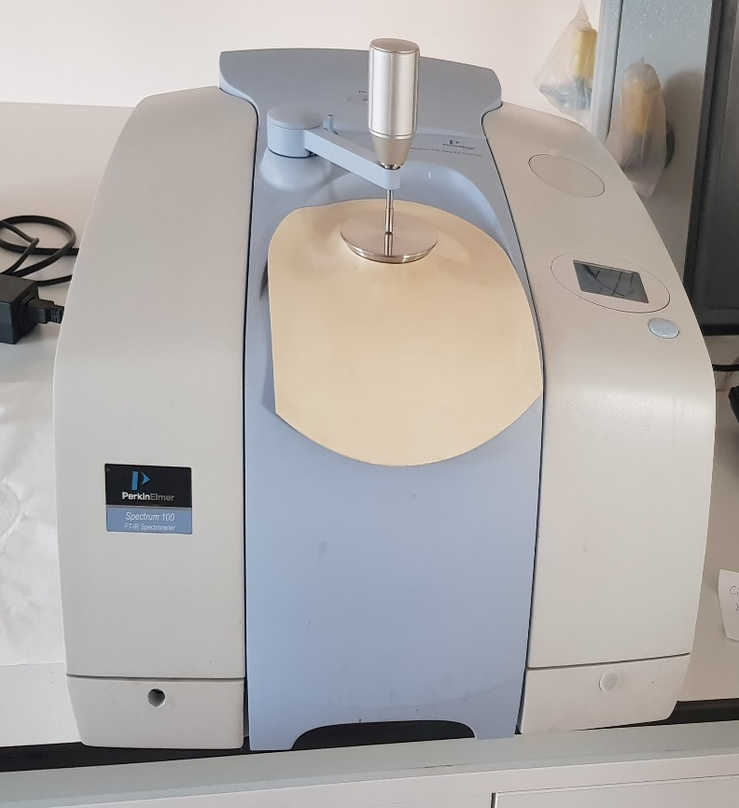
FTIR INSTRUCTIONS

Slide 2
Sign on the notebook
Turn on the computer and sign in (USER)
Check the power of the instrument. In the small panel of instrument “Perkin Elmer Spectrum Series” will be shown if the initialization succeeded, otherwise come to see Nazan Çağlar first

Slide 3
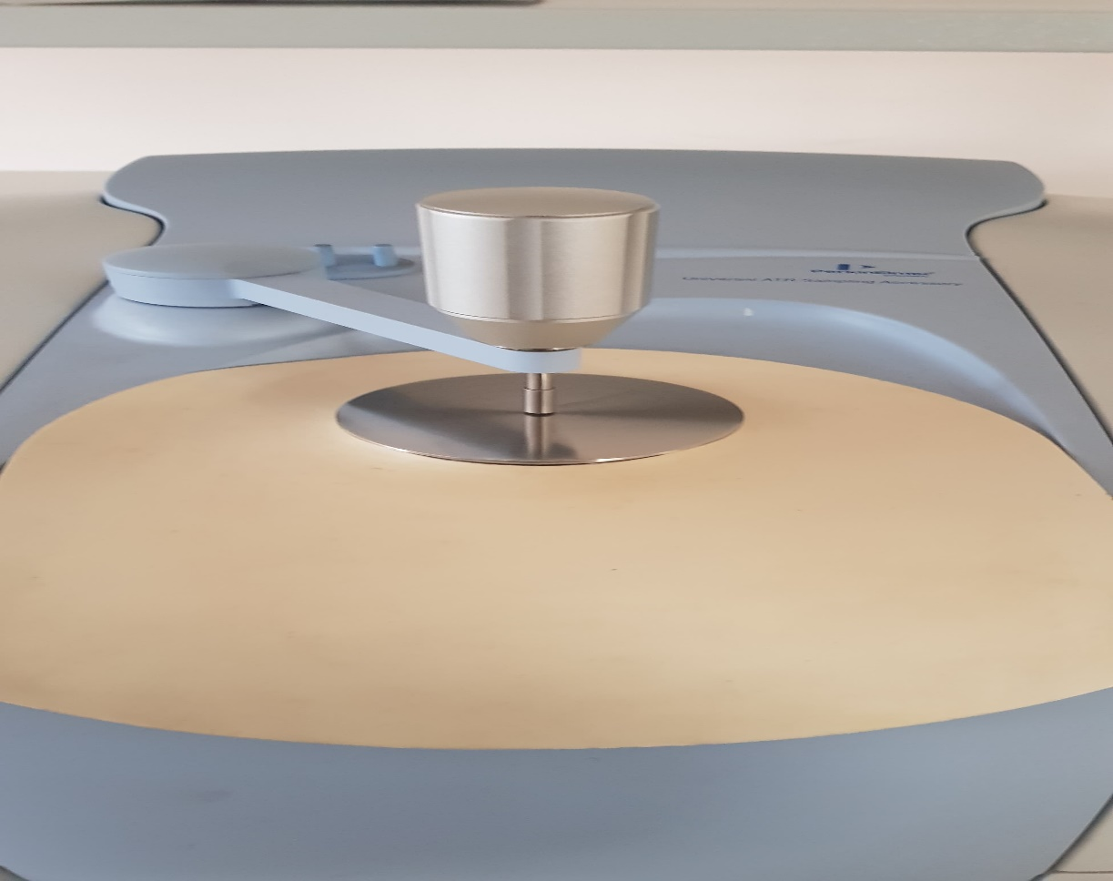
Clean the sample holder by acetone with cotton or wipes, make sure not to splash the acetone on the instrument

Slide 4
Launch the “spectrum” software on the desktop with User Name of “Analyst” and Password “Analyst”, then select “Spectrum 10”
Select “Instrument setup” button, “Scan and Instrument Setup” dialog will pop up, input your sample name, scan range (the range limit is 650-4500 cm⁻¹), and scan number
Click the “back ground” button to collect back group information of the sample holder

Slide 5
Place you sample on the sample holder. Click the “monitor” button on the “Scan and Instrument Setup” dialog first, and then lower down the pressure arm, through the “monitor” dialog to monitor the total pressure applied to the sample, set the “Force Gauge” to be around 90. Press “Apply” and then “Start” to collect the spectrum
Turn to adjust Force Gauge
Put Sample here

Slide 6
Data processing and Data saving:
Peak label: Select “view” from the menu, and then “label peaks”. If you want to label a special peak, “view”-------“cursor”-----“vertical continuous”, then move the cursor to the peak you want, and then “view”-----“label cursor”
you can save your data as SPECTRUM by “File”---------“Save as”, the select “sp (*.sp) as the save as type. Or click “File” …….”Copy to report” ……… “ File” …….. “Copy to Clipboard” and paste to the Word and save your spectrum

Slide 7
Turn off the software, log off the computer, and switch off the instrument. Make sure to clean the sample holder completely before you leave

