Slide 2
What is HPLC?
HPLC is a technique for separation, identification and quantification of components in a mixture.

Slide 3
Carrier phases in HPLC:
Mobile Phase :Mobile phase is the solvent which carries the analyte.
Stationary phase: The substance on which adsorbtion of the analyte (the substance to be seperated during chromatography) takes place.

Slide 4
Main parts of HPLC
Pump
Detector
Injector
Column
Column oven

Slide 5
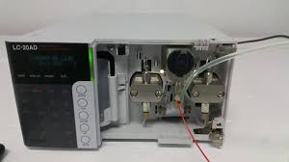
Pump
The role of a pump is to force a liquid (called mobile phase) through the liquid chromatoghraphy at a specific flow rate, expressed in milliliters per min (mL/min).

Slide 6
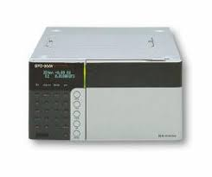
Detector
A detector can see (detect) the individual molecules that come out (elute) from the column.

Slide 7
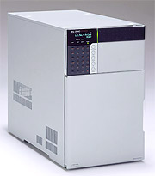
Injector
The injector serves to introduce the liquid sample into the flow stream of the mobile phase.

Slide 8
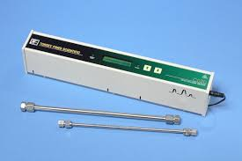
Column
A column is a stainless steel tube packed with stationary phase. It is a vital component and should be maintained properly as per supplier instructions for getting reproducibility and separation efficiency run after run.

Slide 9
Column Oven
Variation of temperature during the analytical run can result in changes of retention time of the eluting components. A column oven maintains constant column temperature using air circulation.

Slide 10
OPERATION OF HPLC
Prepare your solvents and sample
Switch on instrument
Write your method, record and then call it
Open pump
Allow to pass your solvents from instrument without column for a certain time (could be 2-3 hours in a slow flow rate)
When you conclude that it is enough, stopped the pump and place your column.

Slide 11
OPERATION OF HPLC
5. After placement of column, open the pump again and allow the pass of solvent from all system.
6. Do not forget to switch on column oven also.
7. Before sample injection, you have to get a straight baseline.
8. Also, do not forget to make purge before and after the setting of column and also before the sample injection to eliminate undesirable bubbles in the system.

Slide 12
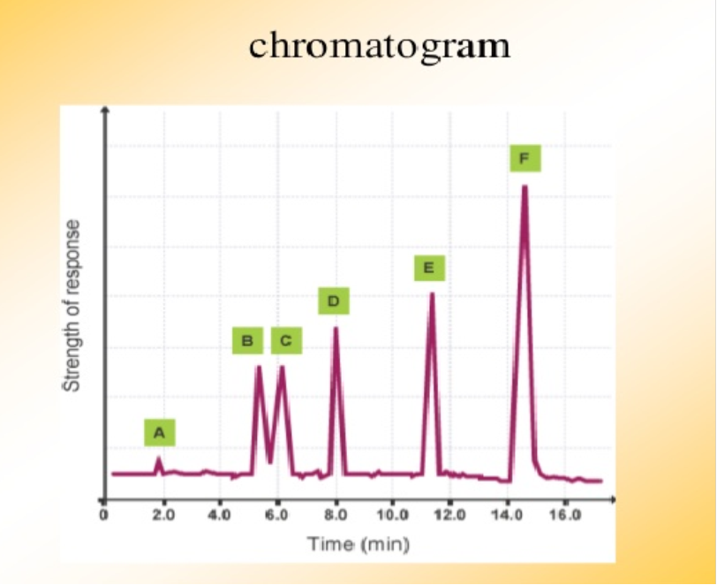
OPERATION OF HPLC
9. After injection, you will obseve the peaks.

Slide 13
10. When you complete your experiment, let to pass of solvent from your column for a certain time in a slow flow rate.
11. Then, switch off the all instrument and take out the column.
12. Write your solvent that you used in your work to the notebook near the HPLC.

