Slide 1
LA950-HORIBA PARTİCLE SİZE ANALYZER
USER MANUAL

Slide 2
About the device
LA950-HORIBA (Partica LA-950, Horiba Ltd., Japan). particle size analyzer is a laser light scattering instrument (Partica LA-950, Horiba Ltd., Japan). The system could detect particle sizes ranging from 10 nm to 3 mm. This instrument measures the intensity of laser light scattered from sample, and then reports the PSD that gives the closest ﬁt between theoretical calculations (Mie theory) and experimental measurements of intensity versus scattering angle.

Slide 3
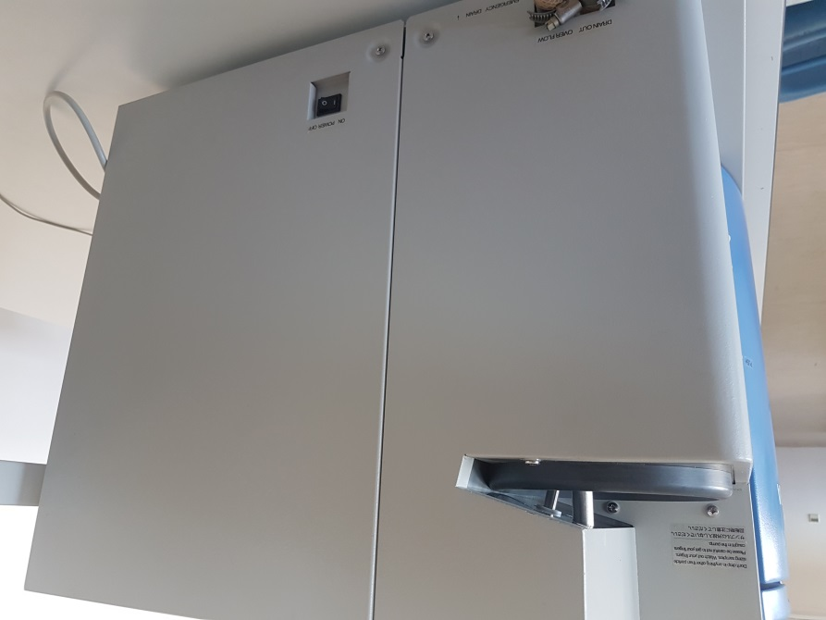
Measurement
To start only use distilled water. (If you need to use oil, it should be organic oil). Check whether disposal bottle is unfilled to prevent any water overflow.
Turn on LA950-Horıba particle size analyzer.

Slide 4
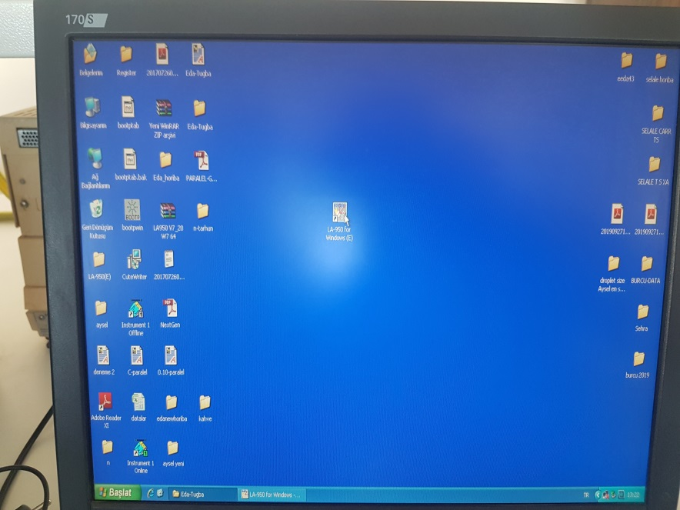
Turn on PC connected to device.
ICON
Open software from the Horiba Icon on the desktop.

Slide 5
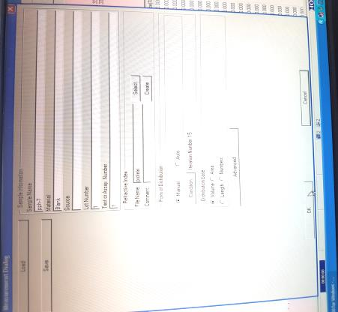
Then start to navigator from software.
Select method, or write your own method conditions manually.
Give sample name and details related to your sample such as RI.That is,for emulsion you can use RI 1.45 and 0 as imagiary part and 1.33 for water. If sample is colored imaginary part should not be equla to 0....but at least you should get a distribution reproducible.

Slide 7
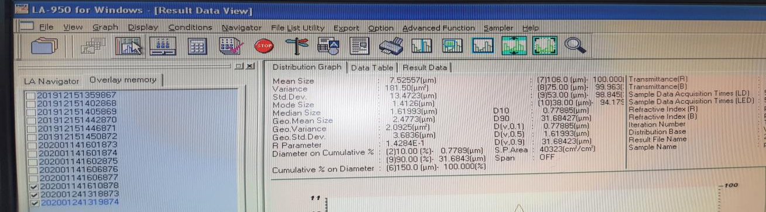
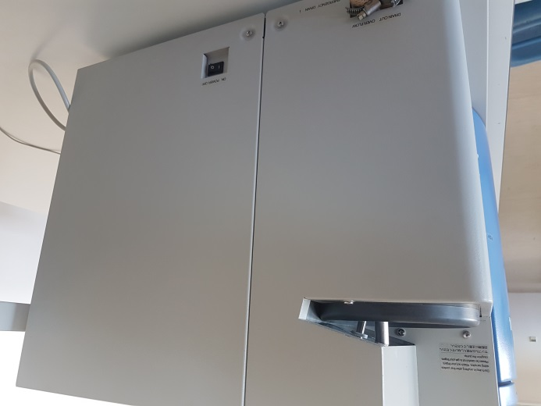
Close the data information window and press measurement bottom.
Before to start measurement, to prevent contamination from previous study rinse with distilled water the device twice prior to analyses.
Sample chamber (distilled water
and/or sample will be entered here.)
Fill with distilled water just one
or two cm above the white blender
of the device.

Slide 8
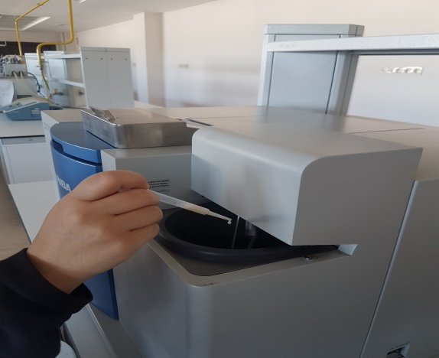
Note:
During proccessing, signals such as the cell is not set , front door is open can be neglected.
If water level decreases while circulation you can add up to the suitable level.
For Emulsion, NEVER APPLY Ultrasonics as you may destroy the emulsion, use LOW PUMP SPEED (2).
During application follow this steps;
FEED; De-bubble 2 times; start circulation (Pump Level 2, always open); agitation (Level 2); Check baseline( you should have flat baseline, (not more than 500 as Intensity on Each detectors, left windows). On right windows you should not see any size appearing); align; blank; introduce your sample; make measurement.

Slide 9
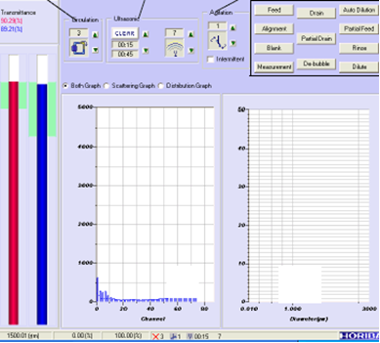
Check baseline, you should have flat baseline, as shown (not more than 500 as Intensity on Each detectors, left windows). On right windows you should not see any size appearing.
When your baseline is like that, then align and then do blank. You should have 100% of laser light for Red and blue light. Then introduce the sample gradually to get a transmittance around 90% on blue light.

Slide 10
Particle size measurements can be reported as
Sauter, or surface mean diameters D₃₂ (D₃₂ = ∑ n_{i}d_{i}³ / ∑ n_{i}d_{i}² ) or
volume mean diameters D₄₃ (D₄₃ = ∑ n_{i}d_{i}⁴ / ∑ n_{i}d_{i}³ ),
where n_{i} is the number of particles with diameter d_{i}. The refractive indices of the dispersed and continuous phases used in the calculations of the particle size distribution (PSD) are generally 1.135 and 1.330, respectively.
To determine the width of the distribution of particle sizes, ‘span’ can be calculated from the following Formula:
Span = [d (v, 90) – d (v, 10)] / d (v, 50)
where, d (v, 10), d (v, 50), and d (v, 90) are diameters at 10, 50, and 90% cumulative volume, respectively. In other words, [d (v, 90) – d (v, 10)] is the range of the data and d (v,50) is the median diameter.

Slide 11
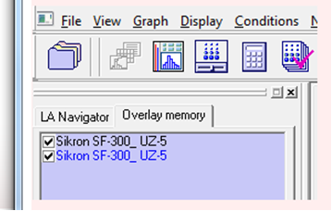
By default the device display D43 if you need D32 you need to recompute data in surface (area). You don't need to make any new measurement. Here the process to make recalculation:
Select the second data and click on recalculaiton icon.
Then select AREA in distribution base field. After data is finished, reload the same data a second time by selecting and click on recalculation icon.

Slide 12
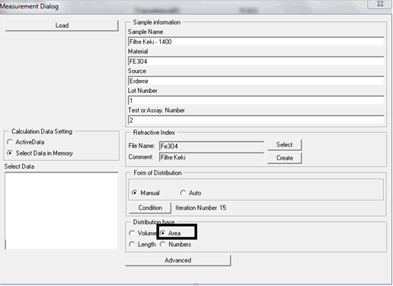
Then the first data will be in Volume base and the second file in Surface base. If you want to keep the file in surface you have to save the data with a different name (for example data in surface....).

Slide 14
After you finished your analyses, save your data then, rinse the device several times by adding distilled water from sample chamber.
To shot down the device, first close software, then computer and finally close the LA950 partica.
For further assistance visit https://www.horiba.com/en_en/

