Slide 1
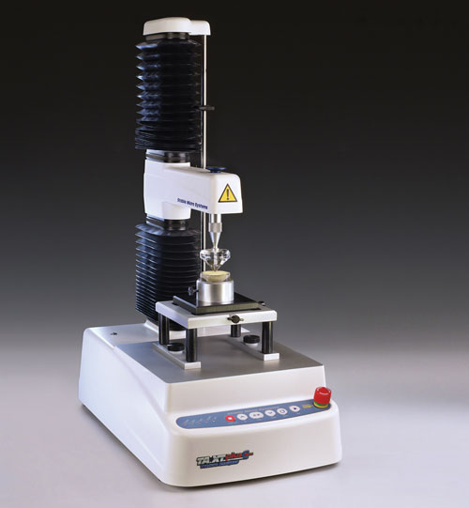
Texture Analyzer

Slide 2
Operation
1. Open the computer and then machine

Slide 3
2. Open the ‘tekstür analizleri’ file on the desktop

Slide 4
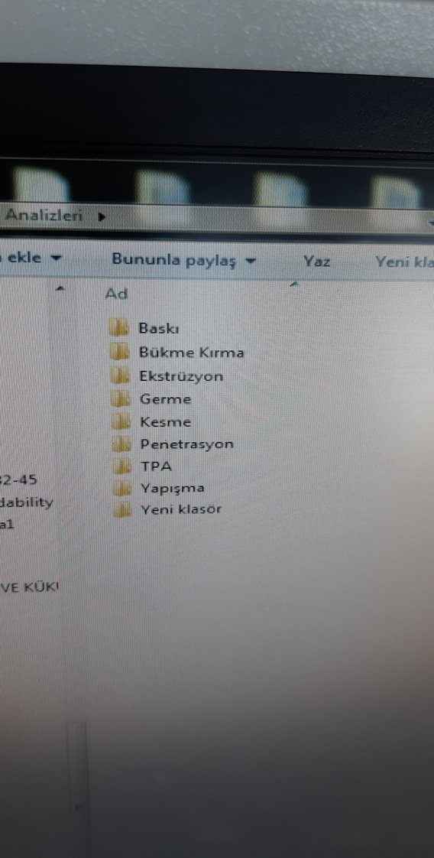
3. Choose your method

Slide 5
4. Open the software

Slide 6
5. Open the tutorials and user tips

Slide 7
6. Next, you will see this page

Slide 8
7. From this page, choose TA settings

Slide 9
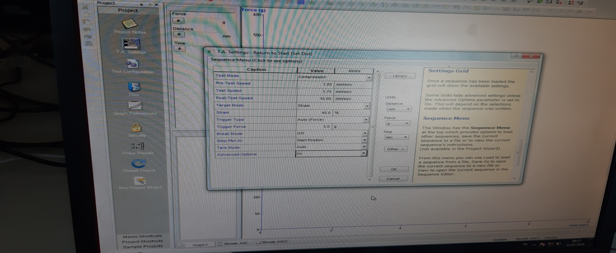
8. Then, write your operation conditions

Slide 10
9. Then, write your project file and record.

Slide 11
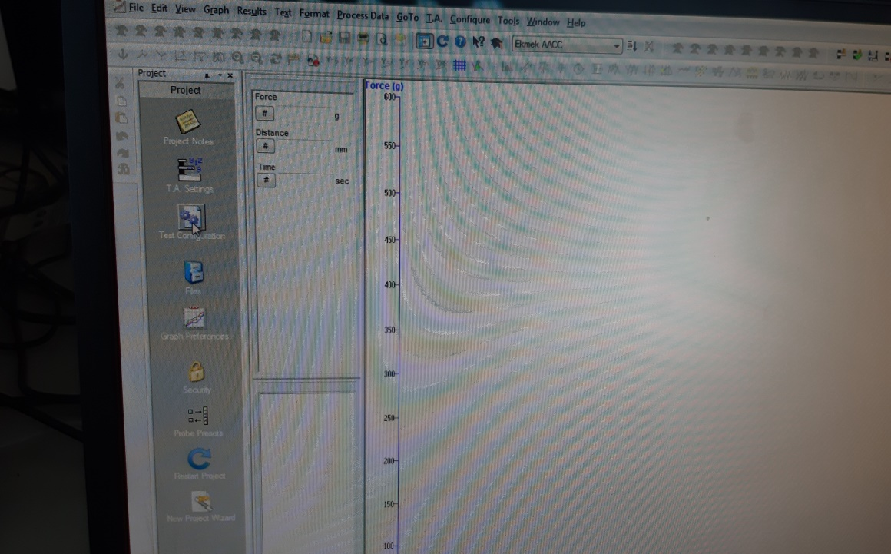
10. Next, open your project file
11. Reach main page that is shown below:
12. From this page call your project file

Slide 12
13. Choose your probe and then place probe to machine

Slide 13
14. Make calibration according to the way defined below:

Slide 14
15. After calibration, place your sample to machine and then apply to T.A to run a test

Slide 15
17. At the end of the experiment, record your outputs and then closed machine and computer.

