Slide 1
BROOKFILED VISCOMETER
USER MANUAL

Slide 2
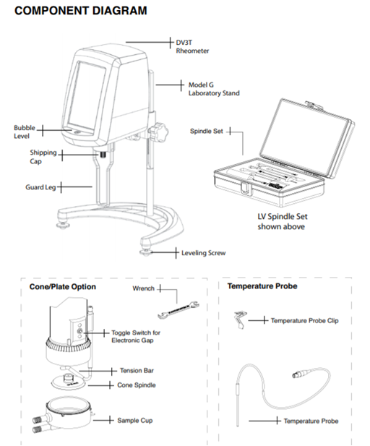
About the device
DV3T has the capability of measuring viscosity over an extremely wide range.
DV3T suitable for medium viscosity range~ > 3cp (these are just approximation, look at manuel booklets)
RV-DV3T suitable for low viscosity range ~ 0.1- 3 cp (these are just approximation, look at manuel booklets)

Slide 3
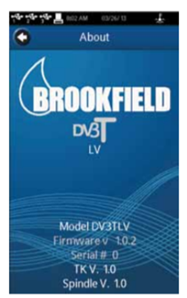
Power up
Turn on the device from power bottom which is on backside. (There should not be spindle during opening or turning off the device). The DV3T will go through a Power Up sequence when the power is turned on. The Rheometer will issue a beep, present a blue screen, and finally show the DV3T About screen for 5 seconds.

Slide 4
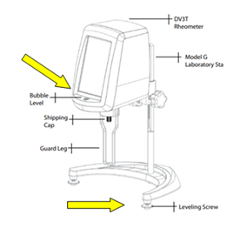
Autozero
The AutoZero screen will be presented automatically, after the About screen, during a power up. The operator must ensure that the rheometer is level and remove any attached spindle or coupling.
The rheometer must be leveled. The level is adjusted using the two leveling screws on the base. Adjust so that the bubble level on the front of the DV3T is centered within the circle by using leveling screws on the feet of device.
Check level periodically during use.

Slide 5
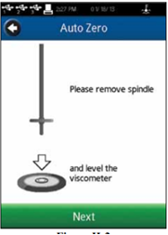
When the Next button is pressed, the rheometer will operate for approximately 13 seconds. TIP: Do not touch the rheometer during the AutoZero process to ensure the best zero value.
After the AutoZero is complete and the operator presses the Next button, the rheometer will transition to the Configure Viscosity Test screen.
Then press next bottom.

Slide 6
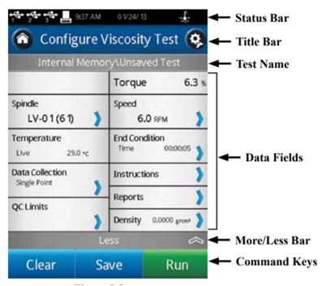
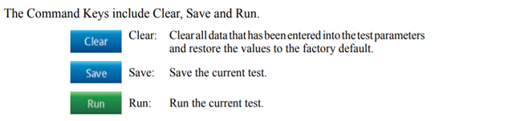
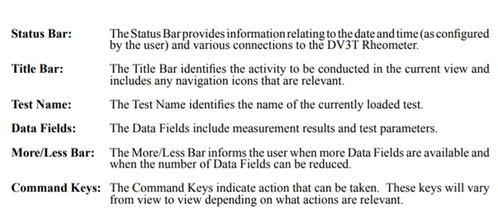
Configure viscosity test

Slide 7
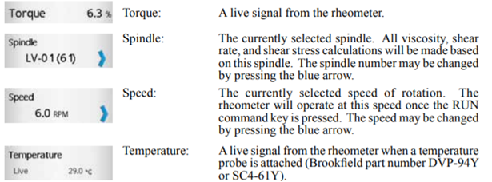
Select appropriate spindle (spindle code), speed and sample volume from manual booklet then insert it on the device carefully due to selected spindle.
By marking with special soft pen of the device write necessary information such as temperature, speed (rpm), spindle type (spindle code or number, find from manual booklet) on the touch screen due to the literature data or just by screening tests. If you need temperature control you can attach water bath to the device and set thee desired temperature scale. Keep in mind, temperature adjustment just only applicable to some spindles.

Slide 8
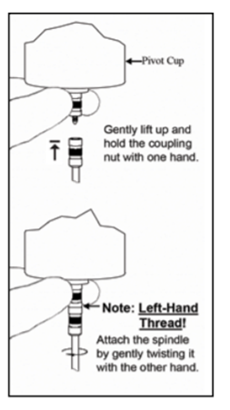
The spindles are attached to the rheometer by screwing them onto the coupling nut on the lower shaft (as shown). Note that the spindles have a left-hand thread. The lower shaft should be secured and slightly lifted with one hand while screwing the spindle to the left. The face of the spindle nut and the matching surface on the lower shaft should be smooth and clean to prevent eccentric rotation of the spindle. Spindles can be identified by the number on the side of the spindle coupling nut.

Slide 9
Save adjustments to the internal memory of the device.
Internal memory → users→ admistrators→ new folder→write file name→ save→ ok
Call method from home screen.
Gap adjustment
Make gap adjustment, please do not forget, spindle cone probe should never be drawn or dropped.
Fix the key on the hole of the spindle cone probe, insert the selected spindle. Then open the light icon, red and yellow lights will appear, start to turn the wheel on counter clockwise until the yellow light appears. When you see yellow light, you are going to go one thick back to previous point where you do not see yellow light on.
Turn the light off

Slide 10
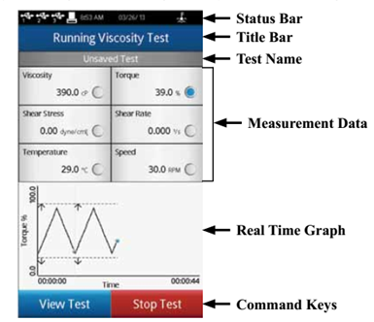
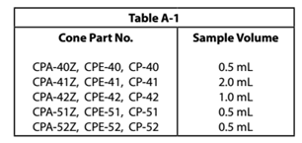
Introduce your sample with considering appropriate sample volume (look manual booklet).
Press run icon and make your measurement. As you are going to adjust measurement conditions manually, torque value should be between 10 to 90 % during the analysis.
When viscosity value became constant stop the test, then press ok, then save result.

Slide 11

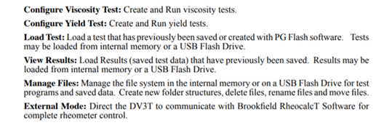
After analyses you can make several operations using home screen. i.e., you can view your results from calling data from load test→view results.
Home screen
The DV3T Home screen can be accessed by using the Home Icon
The Home screen shows the Main Menu functions and provides access to User Log In and Settings

Slide 12
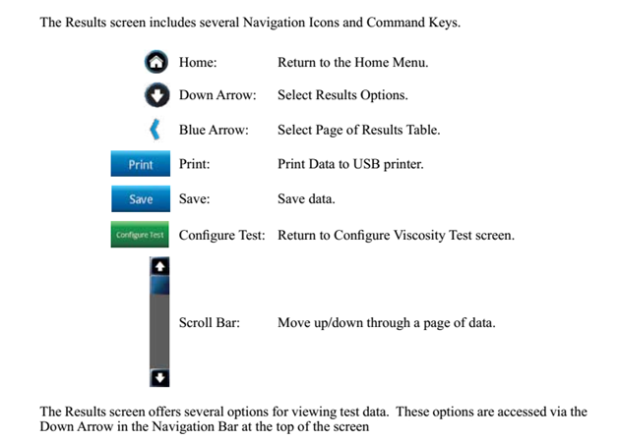
Results

Slide 13
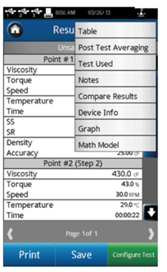
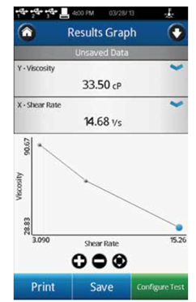
Table: Display all data points: Viscosity, Torque, Speed, Temperature, Time, Shear Stress (SS), Shear Rate (SR), Density, and Accuracy.
Post Test Averaging: Average and Standard Deviation are calculated for measured and calculated parameters including: Viscosity, Torque, Shear Stress, and Temperature.
Test Used: Display the test elements used to generate the data set.
Graph: Display a graph of the collected data. The Graph can be printed if there is an attached printer. The buttons at the bottom of the graph are for zooming in, zooming out, and resetting.

Slide 14
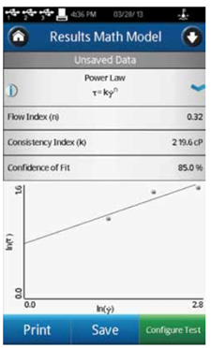
Math models
Math Models available on the DV3T Rheometer include Bingham, Casson, Power Law and etc. Each Math Model will be displayed in equation form with parameter values and confidence of fit calculations shown.
The graph is a visual aid only
and will not be included with a print.
The Power Law equation for a typical set of data

Slide 15
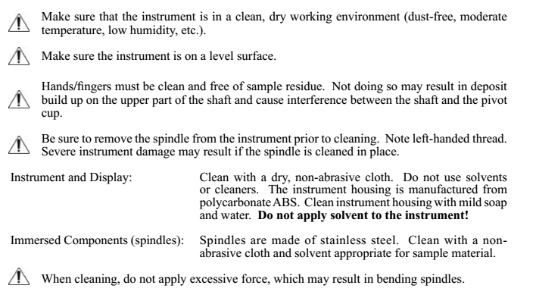
Power down
Remove the spindle, clean the probe and turn off the device.
Cleaning

Slide 16
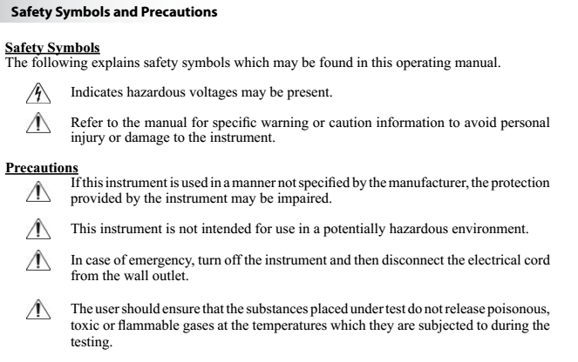

Slide 17
For further assistance visit https://www.brookfieldengineering.com

