Slide 1
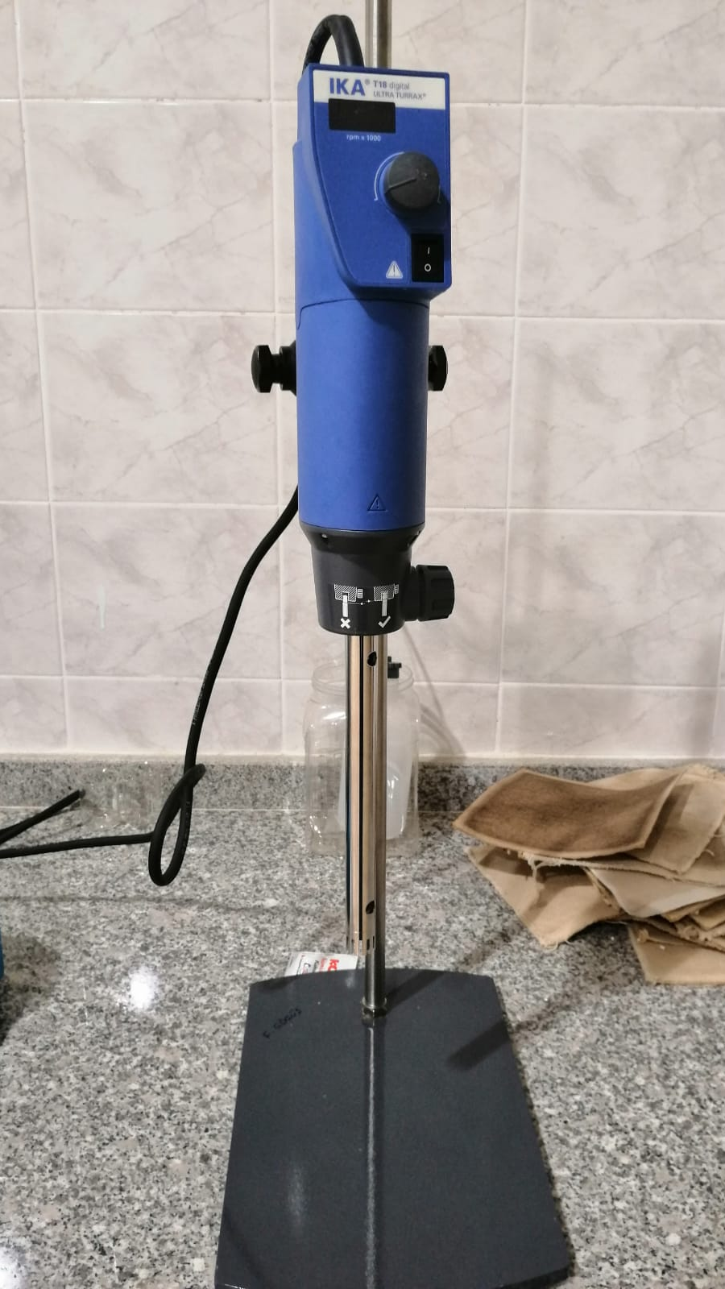
Homogenizer

Slide 2
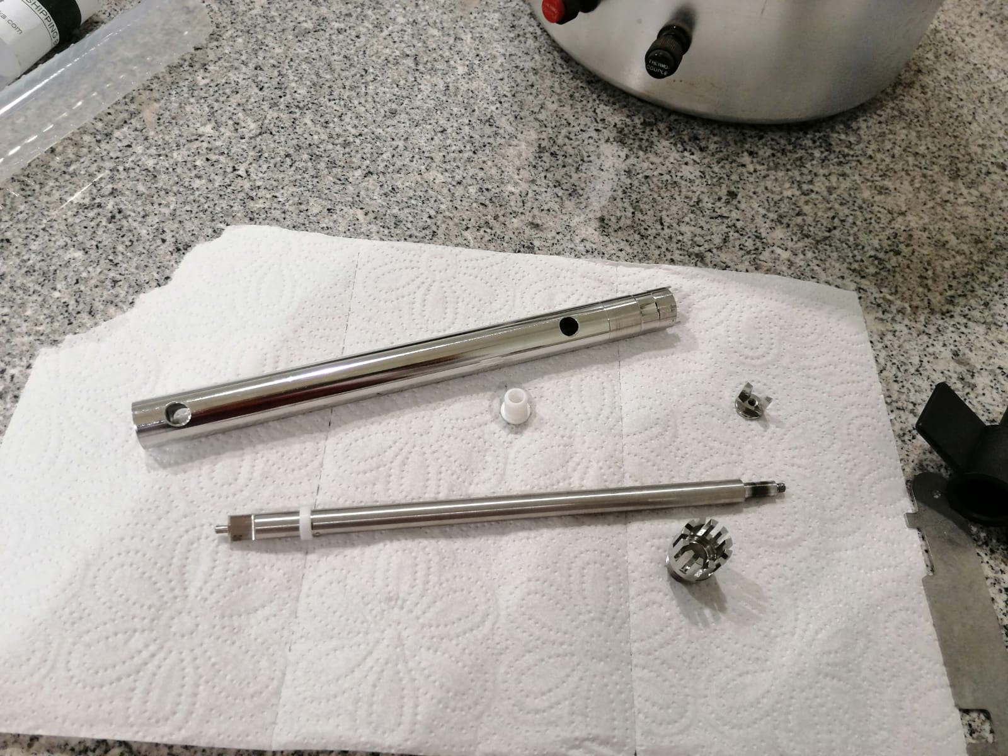
Drive shaft
Shaft tube
Teflon seal
Stator
Rotor
1
3
5
2
4

Slide 3
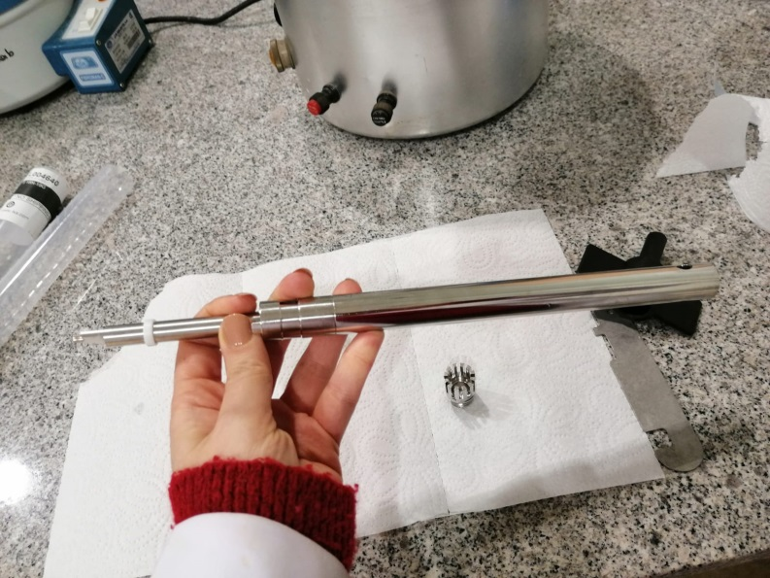
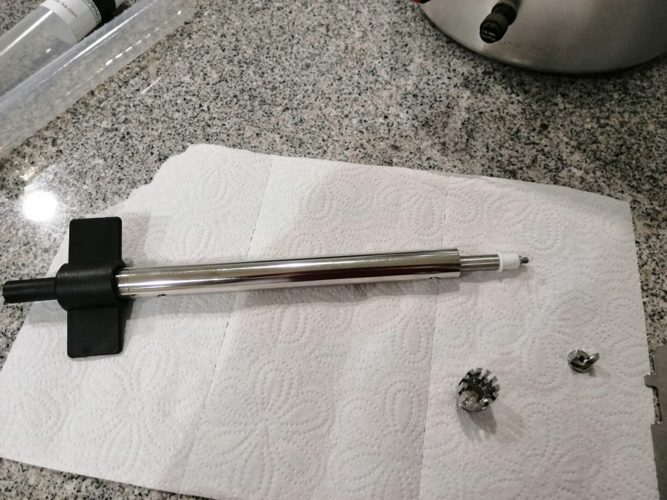
Insert the drive shaft into shaft tube
1.
2.
Position teflon seal over the shaft sleeve

Slide 4
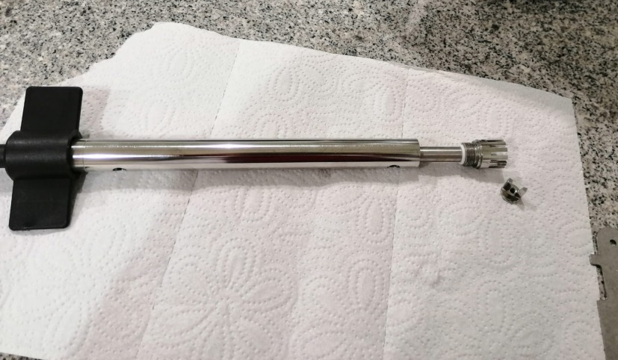
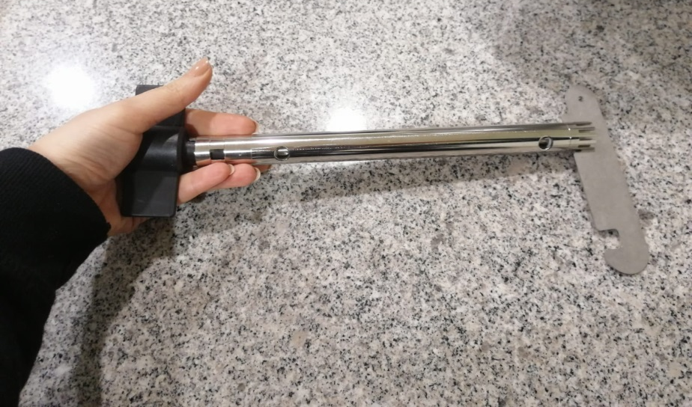
3.
Screw the stator onto the shaft tube, turning counterclockwise
4.
Screw the rotor onto the drive shaft and turn clockwise using the flat key as a counter tool.

Slide 5
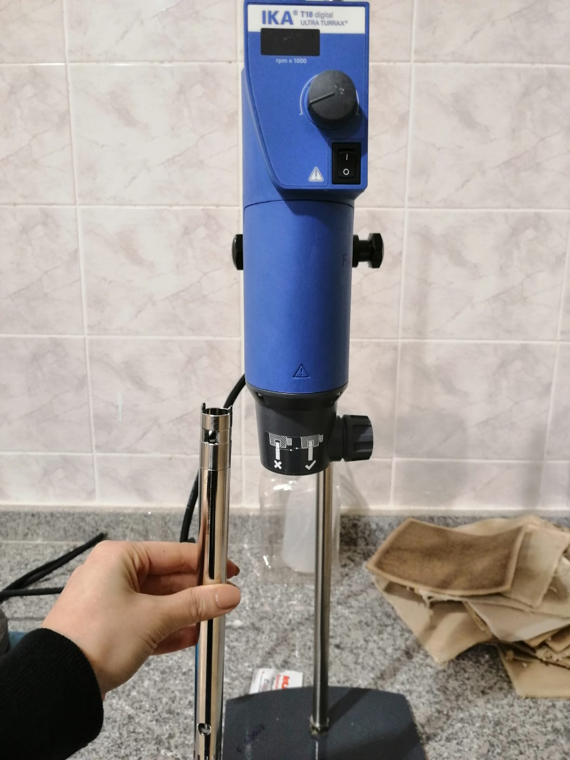
5.
Open the knurled screw (pos. 2)
Insert the dispersing element (pos. 1)
Screw the knurled screw tight (pos. 2)
1
2

Slide 6
6.
Turn on the divice
Adjust the rpm

