Slide 1
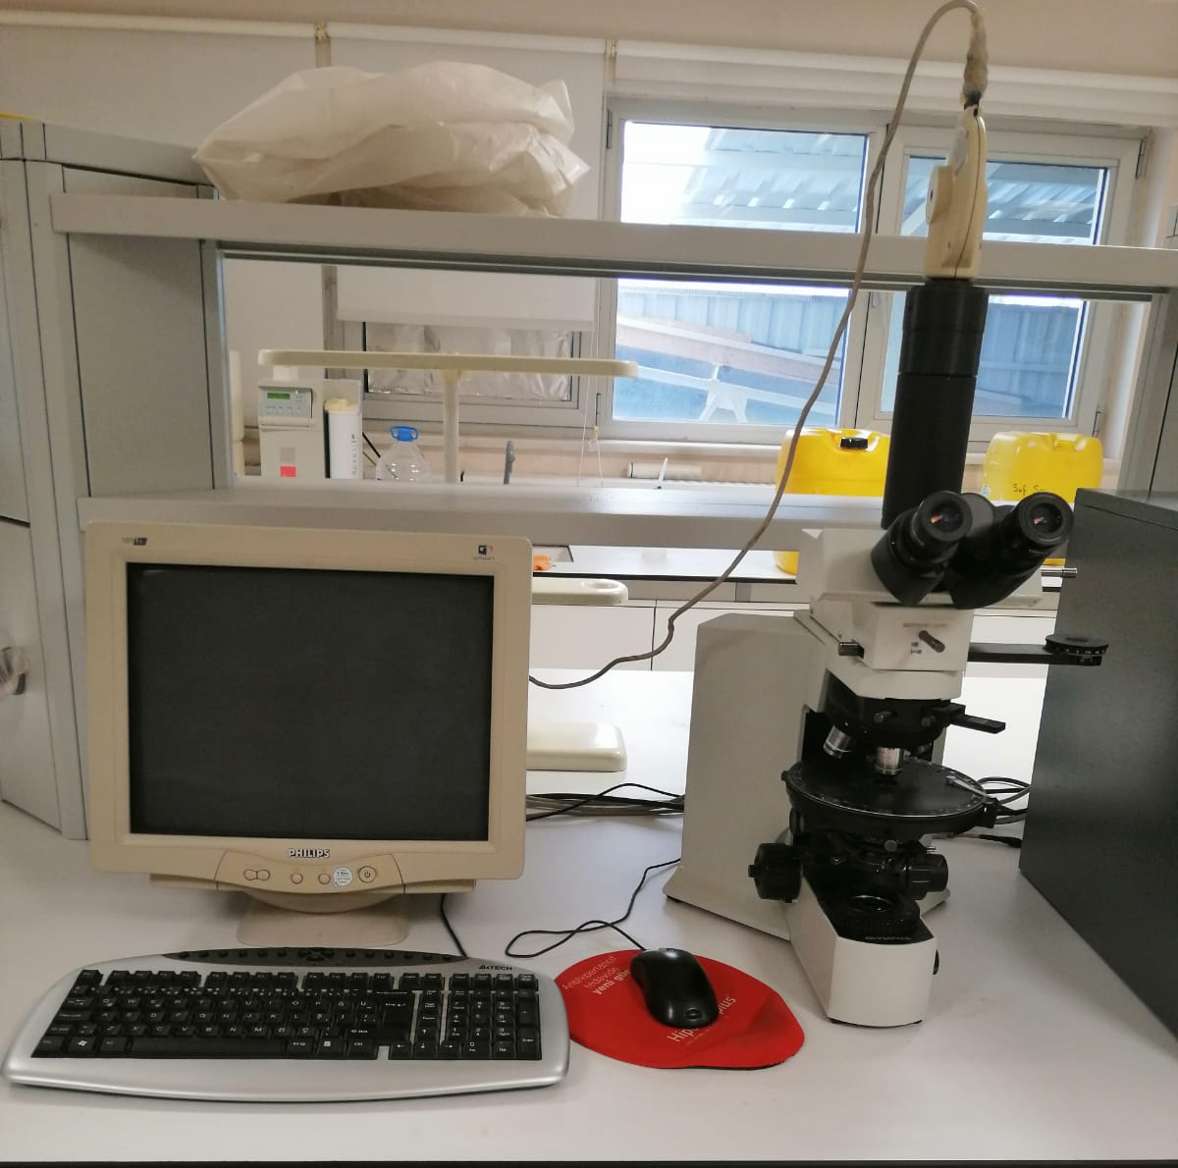
Polarized Light Microscope

Slide 2
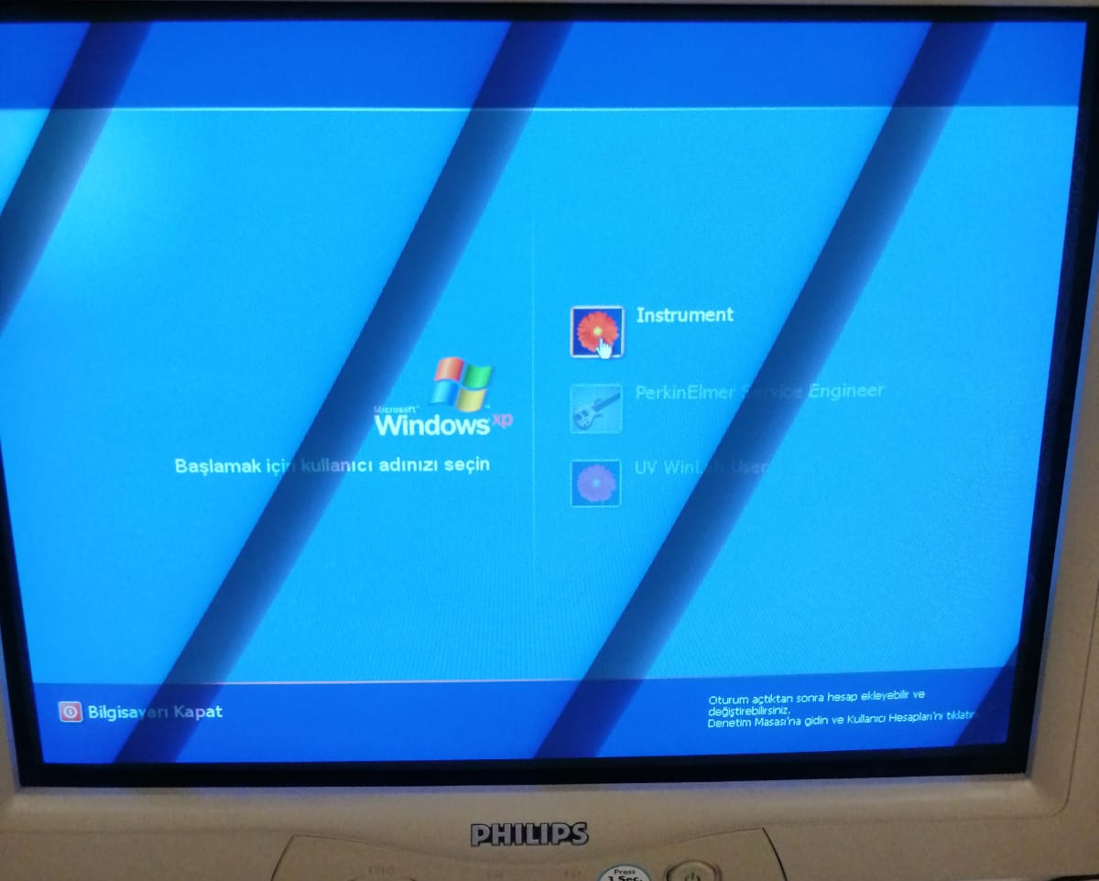
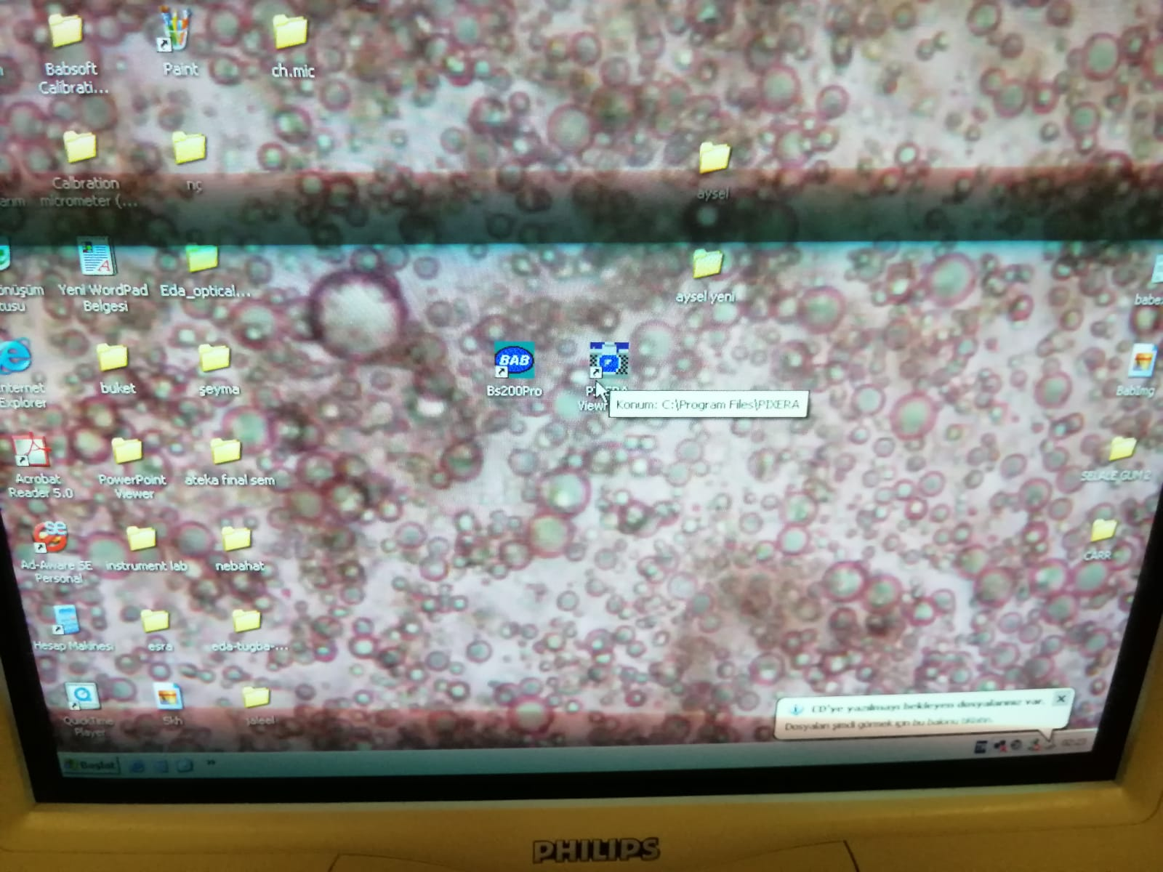
1.
Turn on the computer
2.
Click pixera viewfinder program

Slide 3
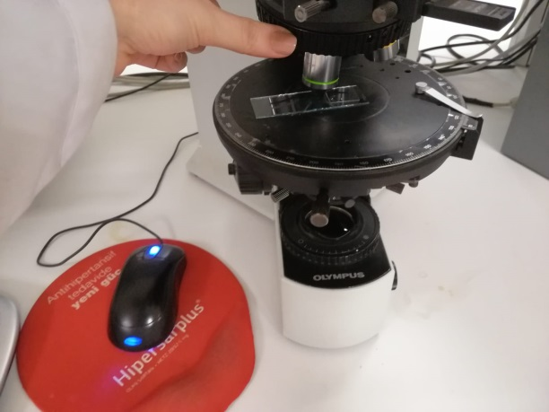
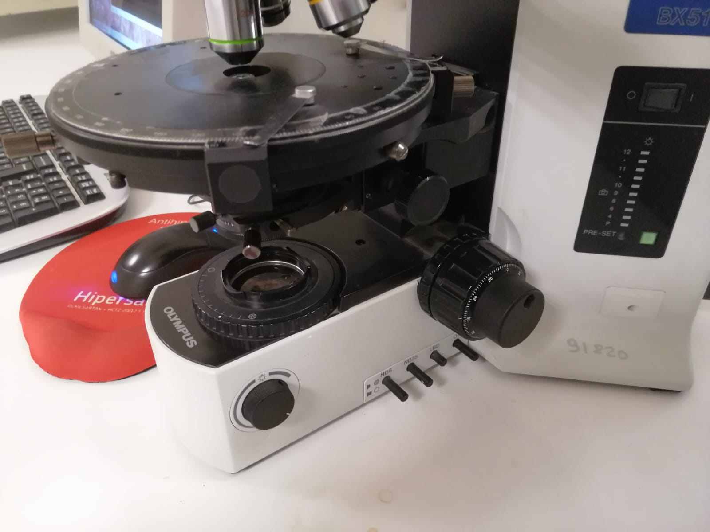
Place slides with a cover slip or cover glass onto the stage and select objective lens (10X ,20X, 40X and 100X)
3.
4.
Use the coarse focus knob to get the specimen in view,
and then arrange the fine focus knob to bring the adjusted slide into focus.

Slide 4
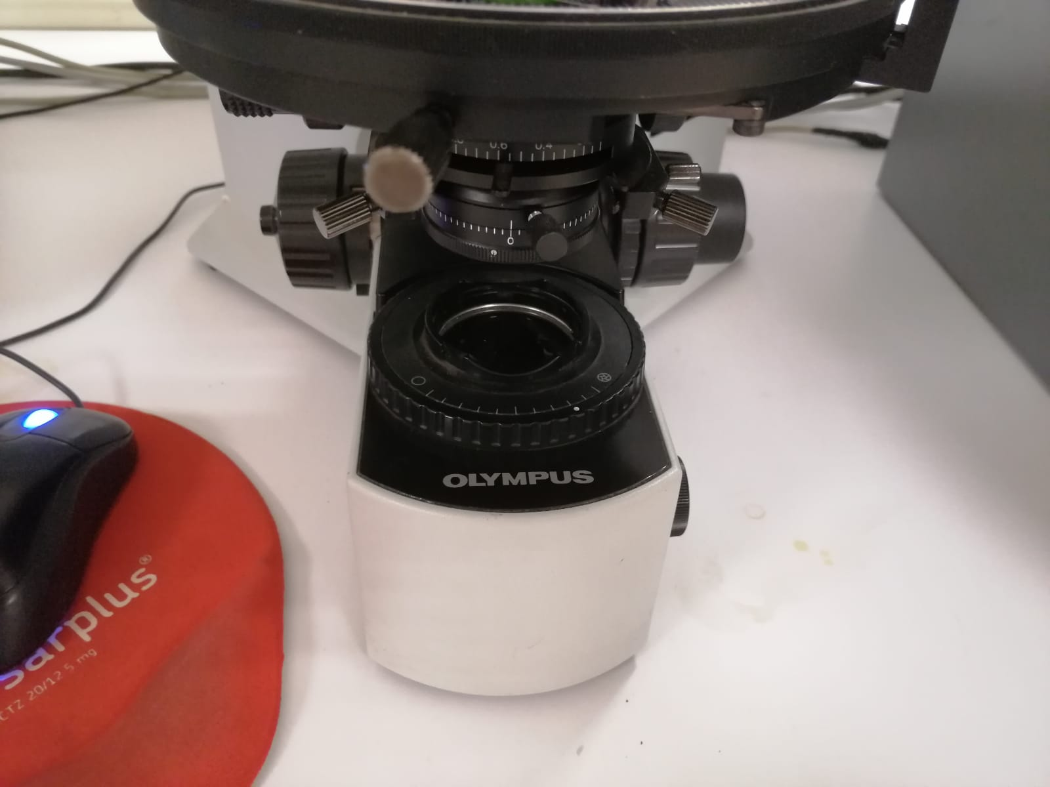
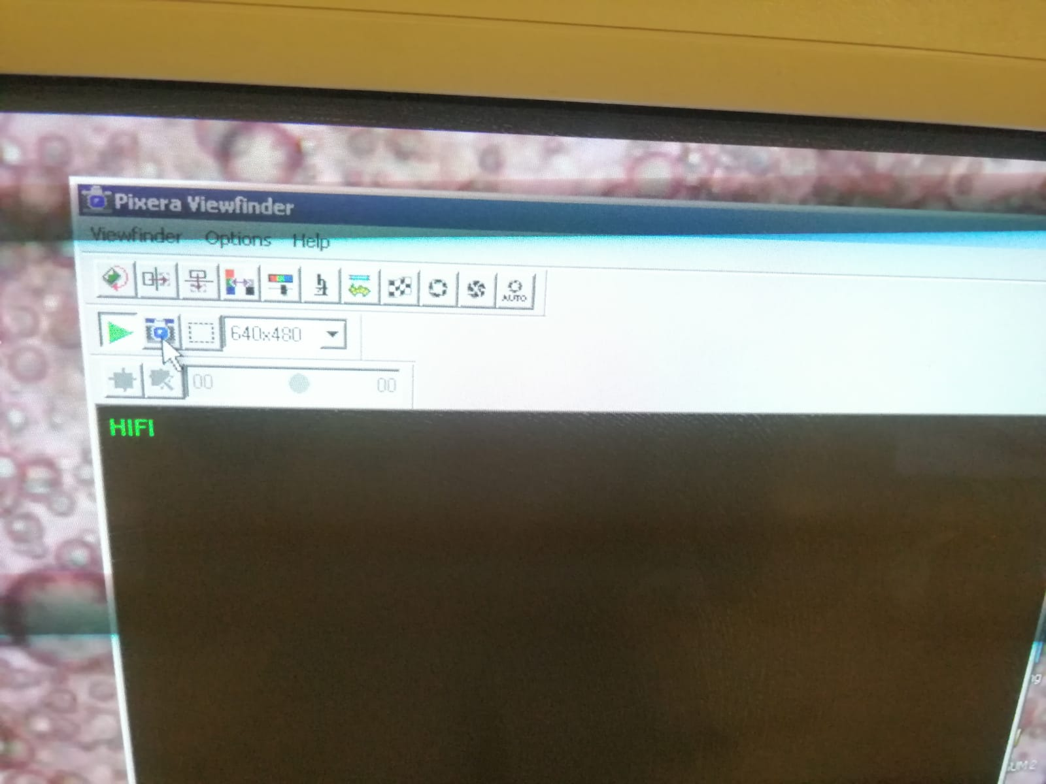
Adjust the light
5.
Click the it to get image.
6.

